Slide 1

Building Up End-to-End Deep Learning Environment from Open Source Frameworks
One Click Deep Learning
Presenter: Baiyu Huo
Concordia University
Gina Cody School of Engineering and Computer Science
Copyright © 2019. Concordia University All rights reserved.
05/22/2019

Slide 2


The role of capsule in OCDL
Capsule can be considered as an interface for OCDL where users can access to the deep learning environment through the website
Maintaining a Deep learning environment locally
Using browser to access to the deep learning environment
Difficult to set up the environment
Hard to management the runtimes and libs
Hard to deal with the conflicts
Cross-platform
Low client machine requirement
Platform specific
Easy to push the update
High hardware requirement
No pre-requisite environment needed

Slide 3
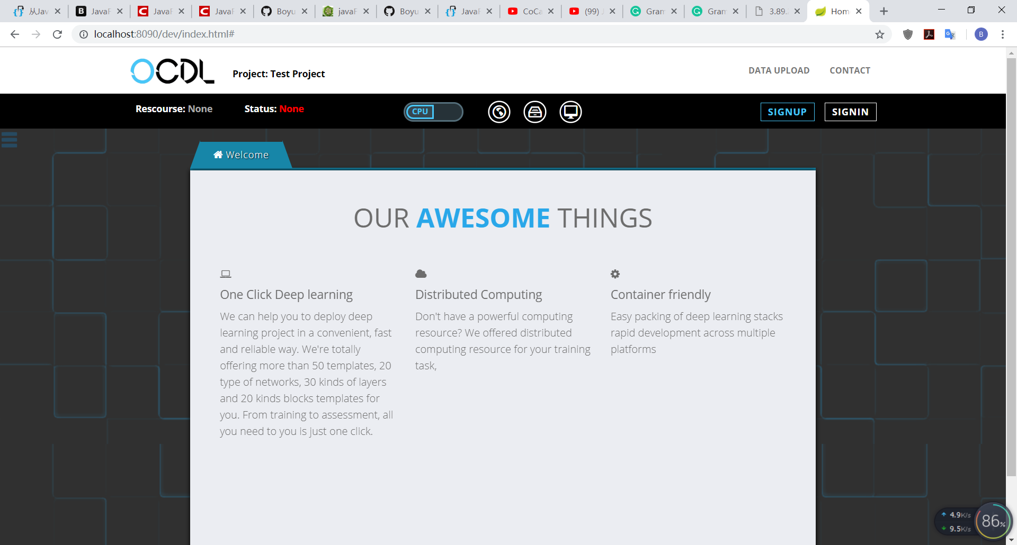


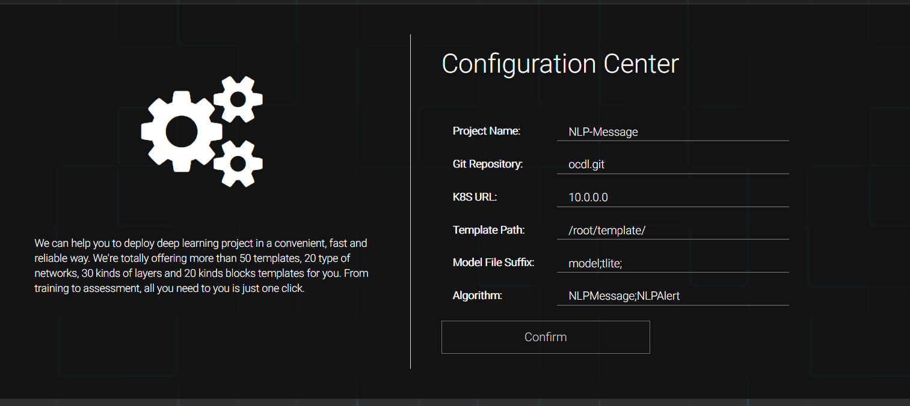

The functions that Capsule provides
Capsule is the single entry of OCDL which contains a set of portals
It provides all the portals:
Project Initialization
Project Configuration
Model Development
Model Management
Model Release

Slide 4
Project Initialization & Configuration
Project Initialization and migration scenio
Initialization -> configuration -> Service Serve -> configuration update -> Service Serve - > migration

Slide 5
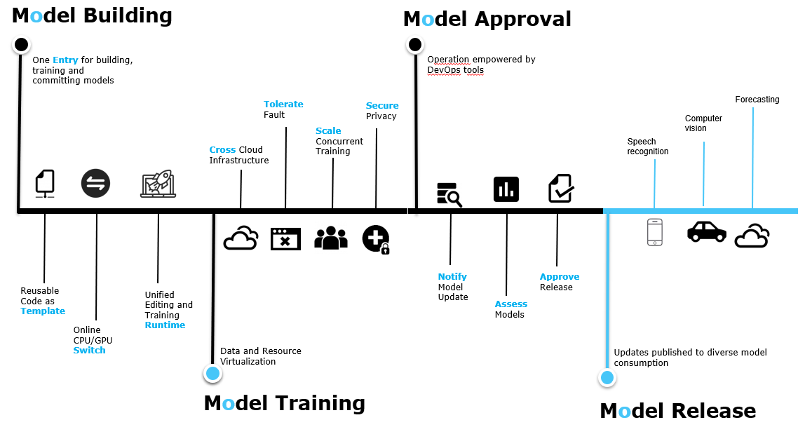
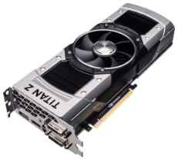

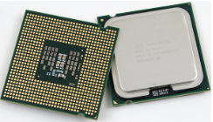







Model Development & Management
Model Building
Model Training
Model Approval
Model Approval
Switch
Approval Staging
Jupyter
Code Template
CPU
GPU
Model Management

Slide 6

Stateless in capsule
The Capsule is completely stateless
Capsule
No database, no configuration file
Memory
Light and flexible
data
All state will be pushed to Rover
data
data
Easily to restore the state for the new capsule application
data
d
d
Server-end Memory cache
Reduce the disk IO consumption
Increase the access speed for data
Rover
Persistence file

Slide 7
Example Scenario
GPU Switch: Click switcher -> Send Resource request -> Resource Service -> Rover (-> K8s -> launch underlying container -> return the address) -> Get Response of Jupyter Server address -> Rendering the portal
Model Evaluate: …

Slide 8
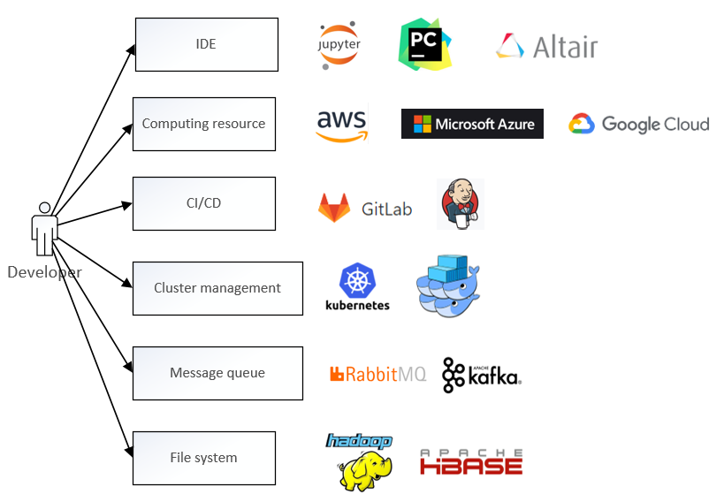
One for All
One entry for all technologies
Feature toggle
Only expose the function that will be used during model development
Low learning curve
No need to care about the implementation of backend
Information hiding
All of the component are black box for users

